Slide 1

Security Tool Demonstration OpenDLP: Data Loss Prevention
Presented by :
A1 - Group 3

Slide 2
OVERVIEW & INSTALLATION

Slide 3
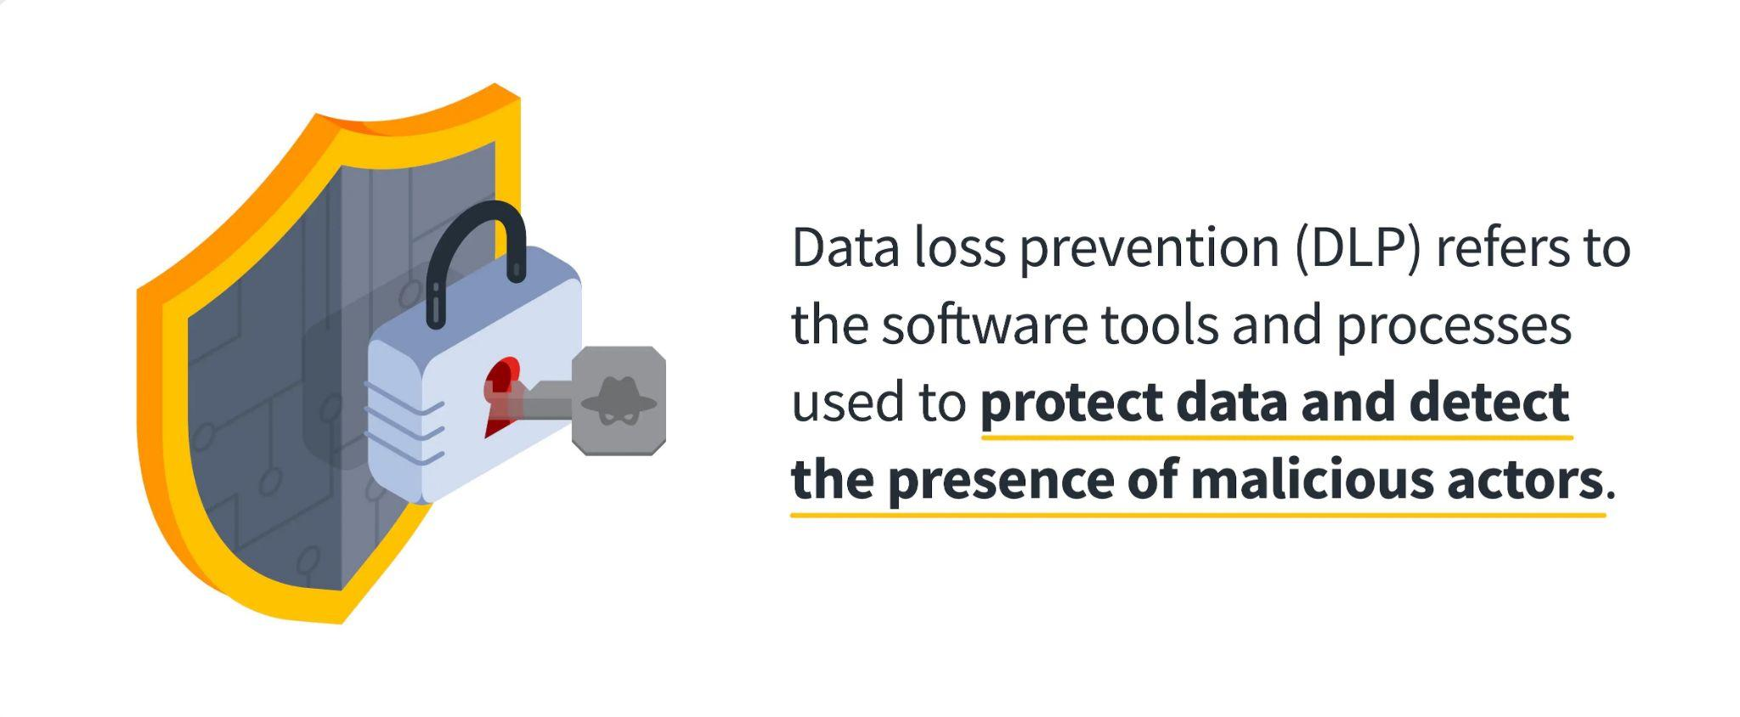
What is DLP

Slide 4
Data loss can be categorized in the following types
Accidental Data loss:
Employees unfamiliar with the company policies
Insecure handling of sensitive materials (employees’ lack of proper training)
Internal Attacks:
Malicious attacks by a person with authorized system access.
External Attacks:
An external attack is an attempt to destroy, expose, alter, disable, steal or gain unauthorized access to physical or logical resources

Slide 5
How DLP software works
Data loss prevention products allow organizations to establish policies for how data should be protected in the following circumstances:
at rest (e.g., data stored on a hard drive)
in motion (e.g., data traveling on a network)
in use (e.g., data being used by someone who is accessing and modifying files)
If any of those violations are identified, DLP enforces remediation with alerts, encryption, and other protective actions to prevent end users.
DLP also provides reporting to meet compliance and auditing requirements and identify areas of weakness and anomalies for forensics and incident response.

Slide 6
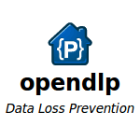
OpenDLP, an open source data loss prevention tool.
Scan databases for sensitive information.
OpenDLP is capable of searching for regular expressions found in cleartext.
OpenDLP is an example of a simplified DLP tool that has a subset of the capabilities of a COTS tool set.

Slide 7
Background
The user can configure the tool to search documents for specific phrases that may identify sensitive information.
The user can also create different scanning profiles to search for specific phrases.
OpenDLP can identify basic Microsoft Office documents and other zip files containing sensitive information.
The reports generated from this tool can be used to further mitigate insider threat through the use of access control lists (ACLs) and auditing.

Slide 8
OpenDLP and Regular Expressions
OpenDLP contains built-in regular expressions (RegExs) for all major credit cards and social security numbers.
Any number of regular expressions can be crafted for a specific need within the organization.
The implementer only needs to have a basic understanding of regular expressions to create new expressions.

Slide 9




Requirements for OpenDLP
Oracle’s VirtualBox
OpenDLP VM image files
Source Code
README-VM.txt
Source code is also available to download and install
README-VM.txt file that is bundled with the virtual machine images contains instructions that should be followed to configure the software properly

Slide 10
Installation
Download all the 7zip files from this link: Google Code Archive - Long-term storage for Google Code Project Hosting.
In Ubuntu, install 7zip and run the following commands: 7za OpenDLP-0.5.1-VM.7z.001
Import “ova” file on VirtualBox.
To connect to openDLP from the host machine, configure networking in “Bridge mode”.
To connect to VM: username-opendlp, password-opendlp
For details information: openDLP/README.md at main · cloudsecuritylabs/openDLP (github.com)

Slide 11
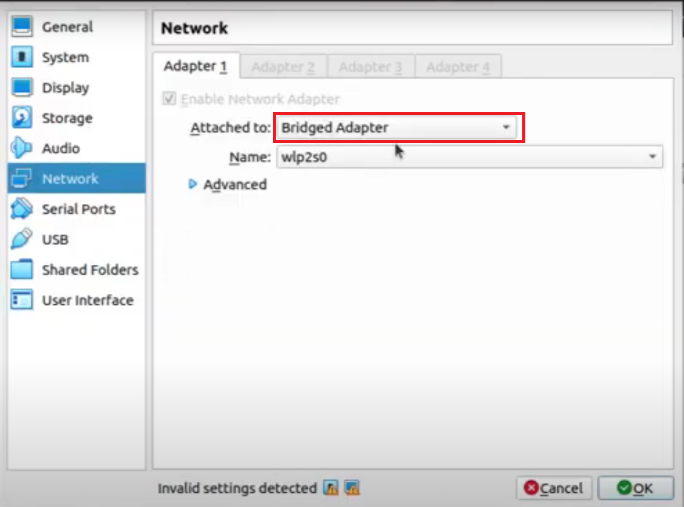
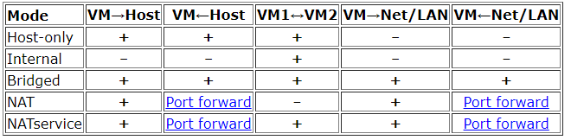
Installation

Slide 12
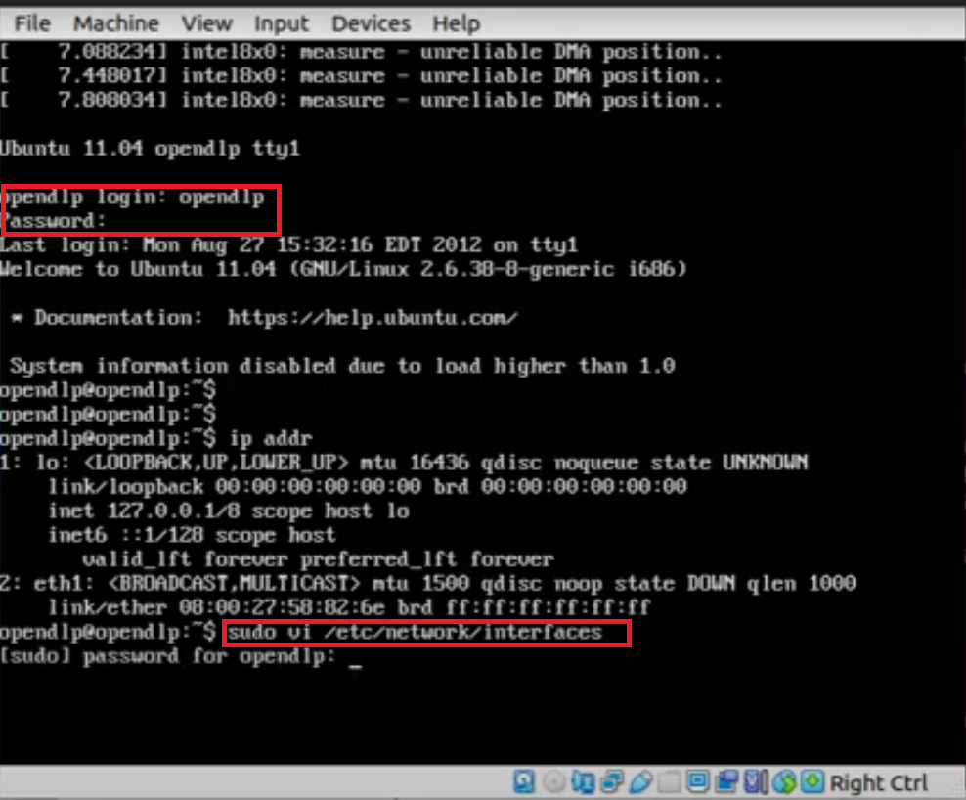
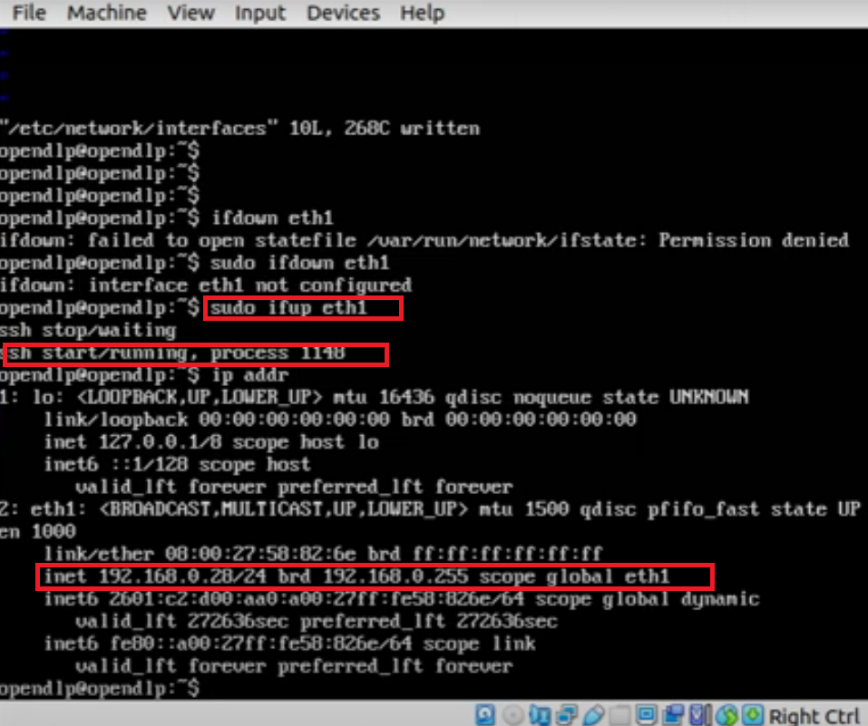
Installation

Slide 13
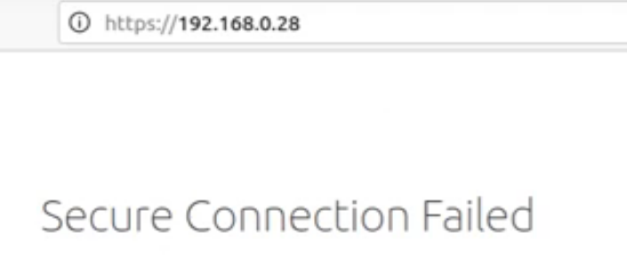
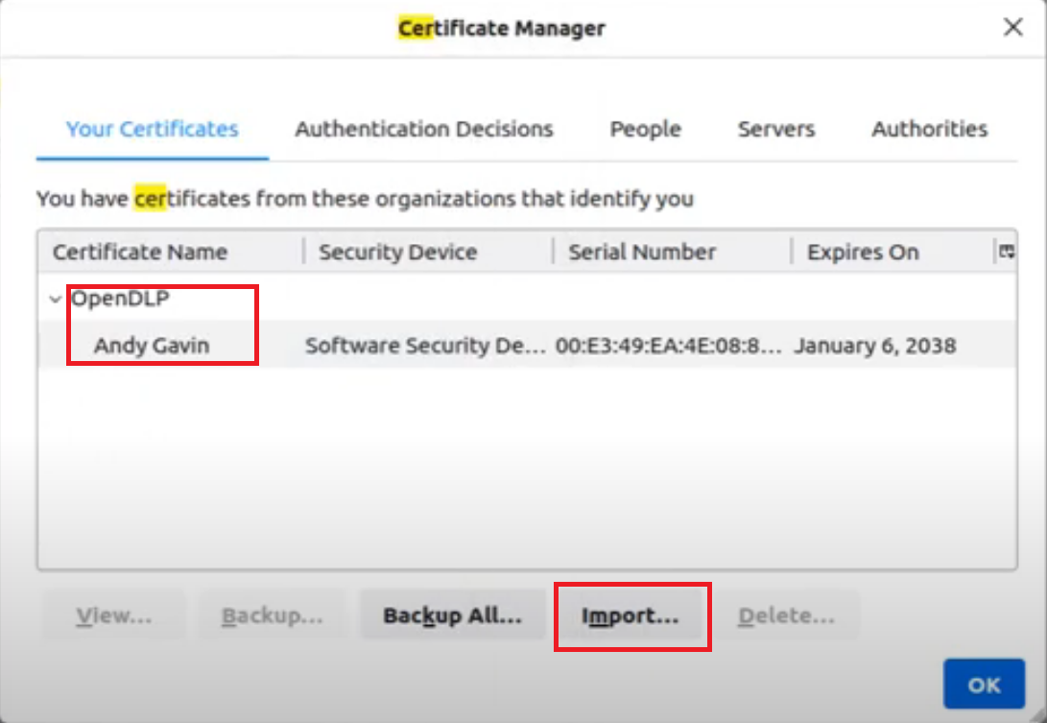
Installation

Slide 14
TECHNICAL DETAILS & PROFILE CREATION

Slide 15
Technical Design & System Architecture
OpenDLP has two types of basic components:
A web application to manage Windows agents, Windows/UNIX/database agentless scanners and scan results.
A microsoft windows agent used to perform accelerated scans of up to thousands of systems simultaneously.

Slide 16
Technical Design & System Architecture
The agent is written in C programming language.
The agents resumes automatically upon system reboots without any interaction from the user.
Securely transmits results to central management web application at user defined intervals over two-way-trusted SSL connections.
To identify sensitive data, it uses Perl Compatible Regular Expressions(PCREs) and can read inside compressed file.
Limits itself to a percent of physical memory of the machine running it.

Slide 17
Working Principle
OpenDLP is a flexible tool that can be used in different, creative ways, but the basic workflow is as follows:
Review the provided Regular Expressions for data to look for
Create a profile with authentication credentials and policy settings
Start a scan by providing a list of IPs.
Review the scan results and mark false positives
Report any suspect business sensitive or compliant data found
Work with the information owners and Office of Information Security to develop a remediation plan

Slide 18
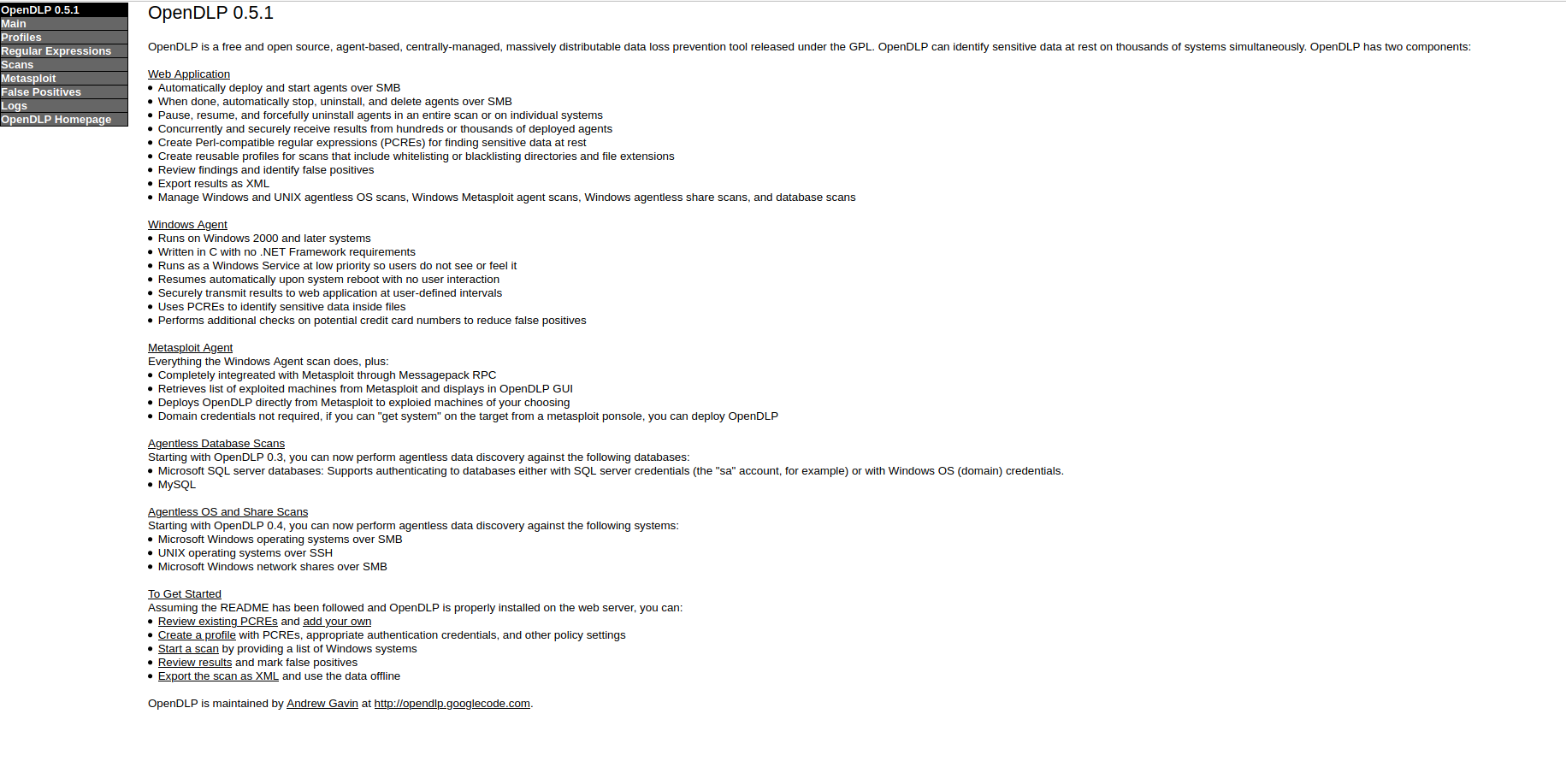
OpenDLP’s Main Interface

Slide 19
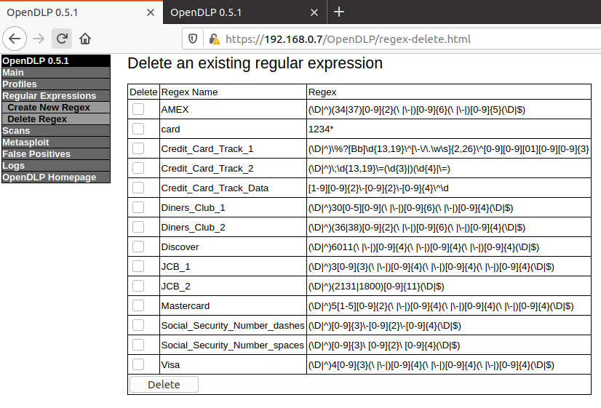
Review the provided Regular Expressions for data to look for

Slide 20
Create a profile with authentication credentials
Enter a profile name in the “Profile Name” field.
Set the scan type to “Linux Filesystem (agentless over SSH).”
Select whether or not you want to mask the sensitive data in the scan results.
Enter the administrator’s username for the targets of the scan and corresponding password.

Slide 21
Profiles
Profiles are used to define the scan types to be done as well as to provide and store the credentials necessary to perform the scan. OpenDLP uses the following profile types:
Windows Filesystem(agent)
Windows Filesystem(agentless over SMB)
Windows File Network Share(agentless SMB)
UNIX Filesystem(agentless over SSH)
Microsoft SQL server(agent)
Mysql(agentless)

Slide 22
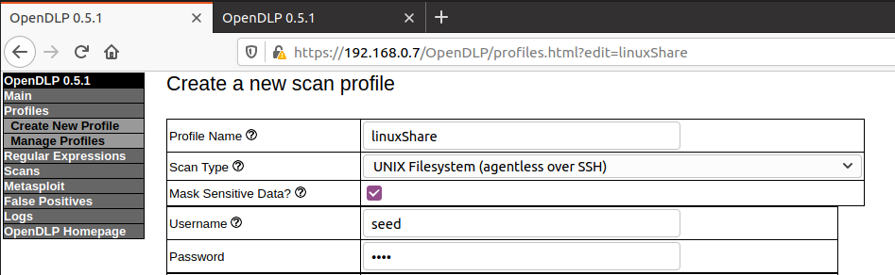
Create a profile with authentication credentials (contd.)

Slide 23
Create a profile with authentication credentials (contd.)
Limit the percent of physical memory of the machine running to a certain value.
Indicate which client directories to scan(e.g., /home/seed/Share).
Set the File Extensions option accordingly.

Slide 24
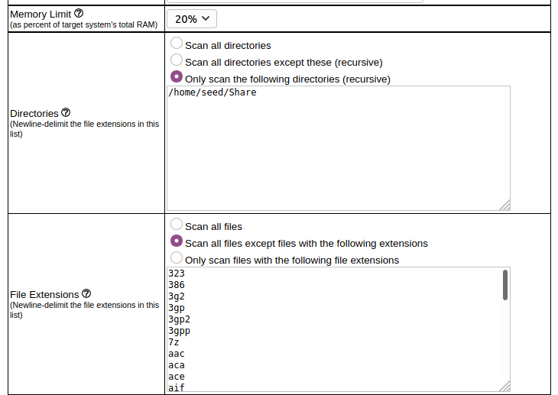
Create a profile with authentication credentials (contd.)

Slide 25
Create a profile with authentication credentials (contd.)
Select the regular expressions to include in the scan(include RegExs for Top Secret, Secret, and Confidential).
Set the concurrent deployments to a number between 1 and 100. Depending on -
Environment
The system resources available to the OpenDLP virtual machine.
The options selected in the scan.
Click the “Submit” button to save the scanning profile

Slide 26
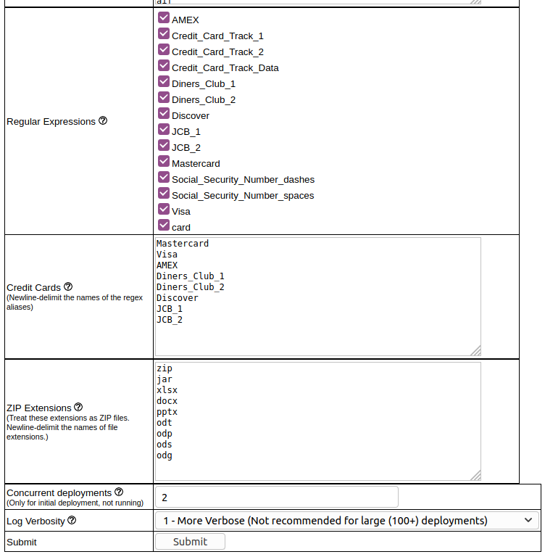
Create a profile with authentication credentials (contd.)

Slide 27
SCANNING & RESULT ANALYSIS

Slide 28
Content Analysis Techniques
Content Analysis using Regular Expressions.
Fingerprinting.
Partial Document Matching.
Statistical Analysis.
Conceptual/Lexicon
Categories

Slide 29
Agent Vs Agentless Scanning
An agent-based scan deploys a software package to a client that searches for sensitive data and returns the results to the OpenDLP server.
Agentless scans are conducted by the OpenDLP server, where the results are processed and stored.

Slide 30
Start a scan by providing a list of IPs
Enter a scan name in the “Scan Name” field.
Select the appropriate scanning profile.
Enter the IP address(es) to include in the scan.
Click the Start button.

Slide 31
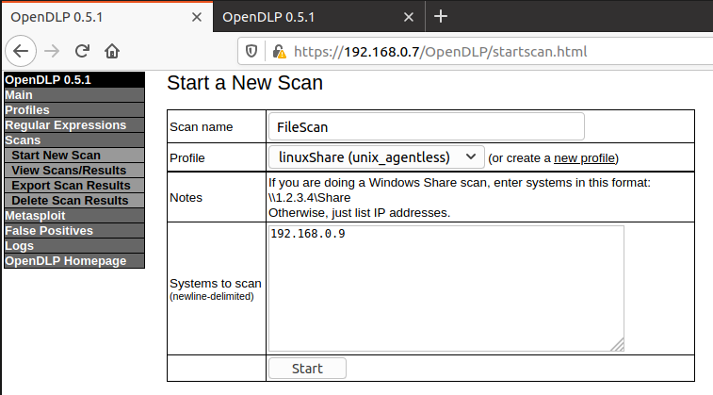
Start a scan by providing a list of IPs(contd.)

Slide 32
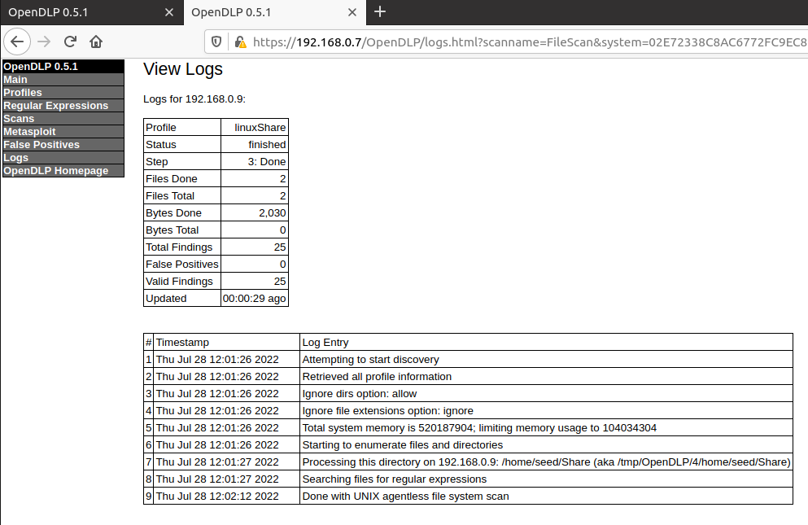
Review the scan results and mark false positives

Slide 33
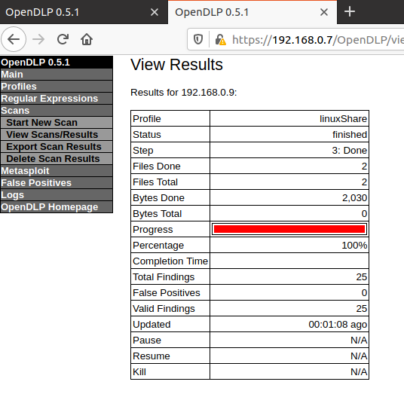
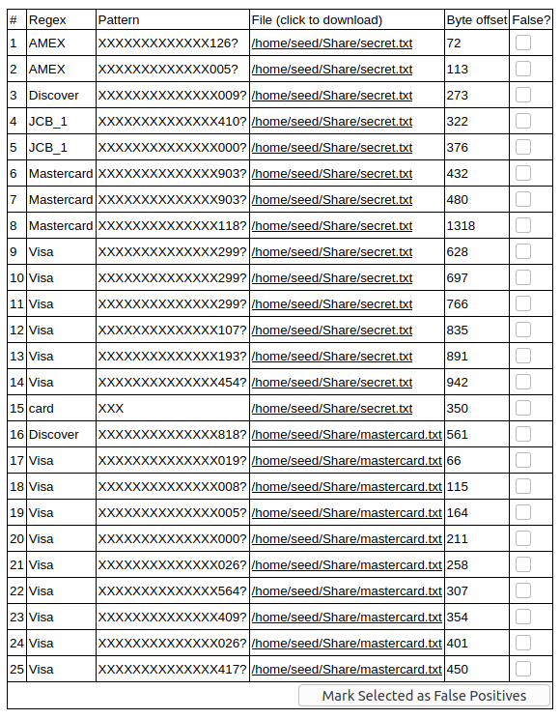
Review the scan results and mark false positives ( contd. )

Slide 34
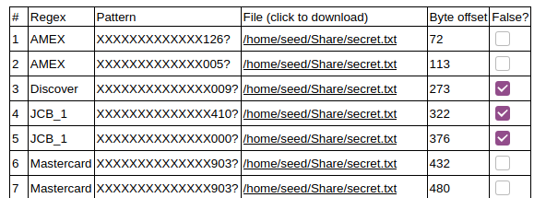
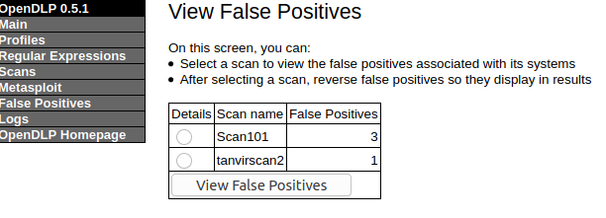
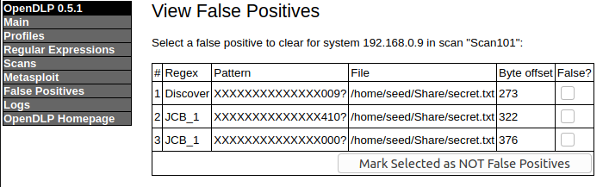
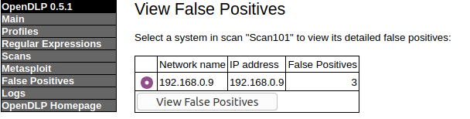
Mark False Positives

Slide 35
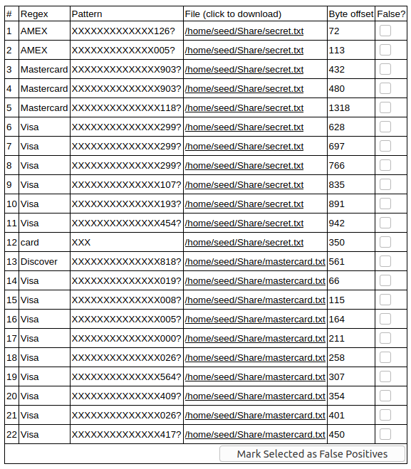
Mark False Positives

Slide 36
Limitations
No advanced content analysis – regex only.
Unable to scan non-plain-text or compressed files ( including current versions of Office ).
Can be defeated by encryption.
Requires NetBIOS, which some environments ban ( Backdated, not used anymore ).
Complicated codebase.

Slide 37
References
openDLP/README.md at main · cloudsecuritylabs/openDLP (github.com)
(244) Install OpenDLP Virtual Machine - Download, Import to Virtual Box, Configure Networking, manage UI - YouTube
(244) OpenDLP: How To Perform Scan-Create Scan Profile, Perform Scan, Review Results, Update Regex (Part2) - YouTube

Slide 38
Thank You

